Slide 1

OUR PROJECT
Twitter Feed (sentiment140)
Find Hashtag
Rank Popularity of Hashtag or Username

Slide 2
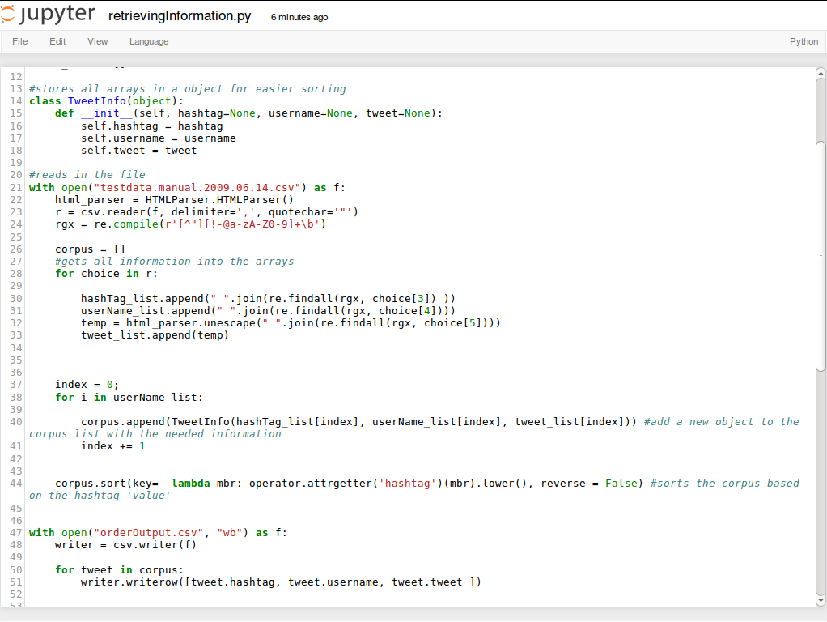
OUR PROGRESS
Understand Code
Clean Data
Ordered Data
Stored Data

